Slide 1
COMP 2710 Software Construction
Dr. Alvin Lim
Auburn University
http://www.eng.auburn.edu/~lim
limalvi@auburn.edu
Fall 2014

Slide 2
Your Background
Not-A-Quiz
Is this course an elective or a required course for you?
What programming languages do you have (any) experience in?
What is your favorite programming language (not necessarily the one you are the most skilled at)?

Slide 3
COMP 2710: Semester Calendar
See the class Canvas page for the most up to date version!
https://auburn.instructure.com/login

Slide 4
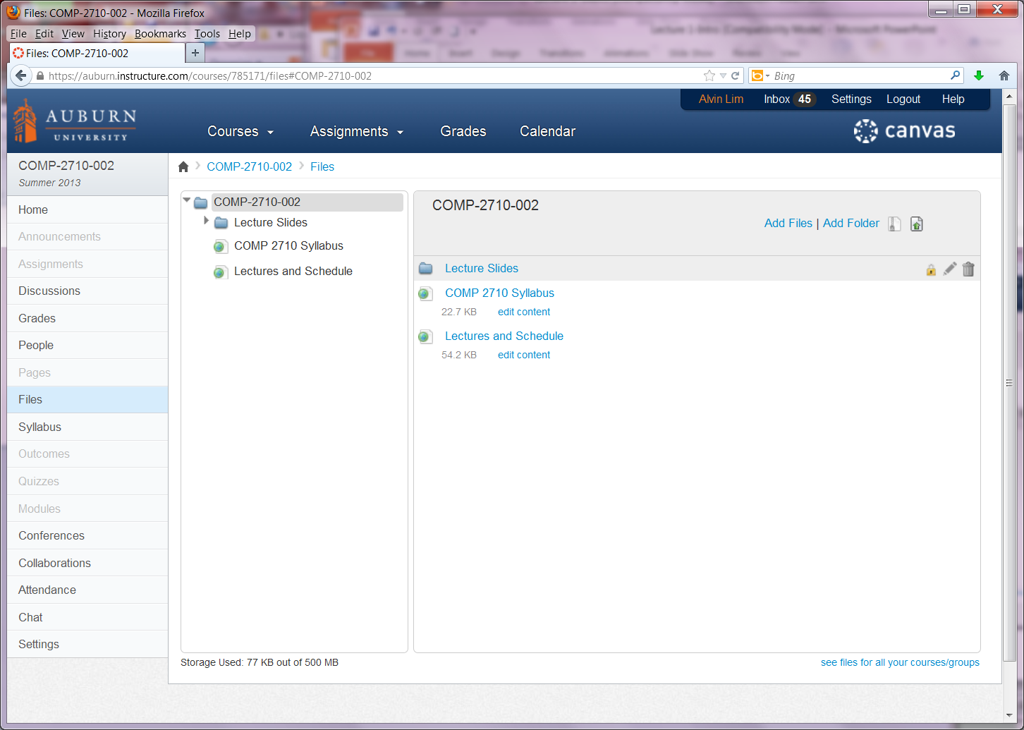
Canvas Screen Shot

Slide 5
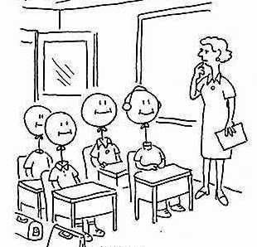
Goal and Objectives
Goal: Compete for positions in the job market or in graduate schools.
Objective 1: Grasp both C++ Syntax and Semantics
Objective 2: Design, implement, and test software
Programming skills
Software design skills

Slide 6
Your Future Career
Careers: Comp. Sci & Eng., Electrical Eng.
Phone and On-site Interviews
Programming skills
Problem solving skills
Personality
Quickly learn a new programming language
Programming experience

Slide 7
COMP 4300 Computer Architecture (Java, C++; C)
COMP 3500 Intro to Operating Systems (C)
COMP 2710 Software Construction (C++)
COMP 2210 Fundamentals of Computing II (Java)
COMP 1210 Fundamentals of Computing I (Java)

Slide 8
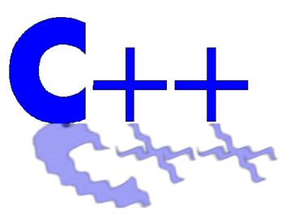
Why Study Software Construction?

Slide 9

C++ Applications
Adobe Systems:
All major applications are developed in C++:
  Photoshop & ImageReady,
  Illustrator,
  Acrobat,
  InDesign,
  GoLive,
  Frame (mostly C, some C++)

Slide 10
C++ Applications (cont).
Amazon.com: Software for large-scale e-commerce.
Google: web search engine, etc.
  Chromium browser.
  Google file system.
  MapReduce large cluster data processing.
HP: Here is a tiny fraction of HP's C++ apps:
  C, C++, Fortran90 compilers, and linker for the new HP IA64 platform (these add to more than 1 million lines of C++ code).
  SAM (HP's system management utility)
  Some of the networking libraries in HP-UX
  Java VM core
IBM:
  OS/400.
  K42: a high performance, open source, general-purpose operating system kernel for cache-coherent multiprocessors.
http://www.research.att.com/~bs/applications.html

Slide 11
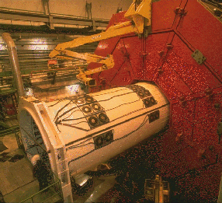

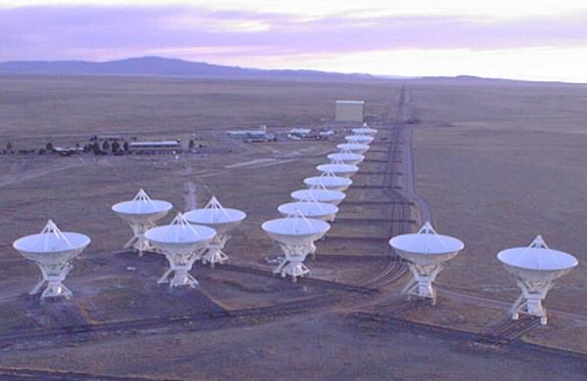
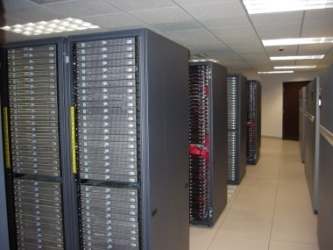
Parallel Applications on Supercomputers
Notes:
biological sequence analysis
Radio Astronomy Observatory

Slide 12

Why Study Software Construction?
Position | Software Engineer - (Posted on 8/13/2011)
Location | Seattle, WA
Company | Amazon
Part of the Job Description | Basic Qualifications * Bachelor's Degree or better in Computer Science or related field. * 4+ years professional experience in software development. * Computer Science fundamentals in object-oriented design, problem solving, data structures and algorithm design * Proficiency in, at least, one modern programming language such as C++, C# and Java. Perl experience a plus.

Slide 13

Why Study Software Construction?
Position | Software Test Specialist - (Posted on 8/14/2010)
Location | San Jose, California
Company | IBM
Part of the Job Description | Applicant should possess a strong programming language such as C, C++ or Java. Command of a non-Windows platform such as Linux or UNIX is also a plus. The applicant should possess any number of the following abilities: Java, C++, C, Linux, Windows, TCP/Networking, Websphere, DB2, Rational Tools, Project Management.
1-<number>

Slide 14

Why Study Software Construction?
Position | Senior Software Engineer - (Posted on 8/15/2009)
Location | Washington, DC
Company | Intel
Part of the Job Description | You should possess at least a Bachelor of Science degree and possibly more advanced degrees with extensive experience as graphics programmer in the video game industry. Additional qualifications include: - Solid understanding of Direct X*, OpenGL*, and Shaders* - Strong experience with C/C++ language and Windows* development environment - A good communicator and comfortable with public speaking - Multithreading experience and computer architecture knowledge would be an added advantage
1-<number>

Slide 15

Why Study Software Construction?
Position | Software Engineer, Compilers (Posted on 8/16/2009)
Location | Mountain View, CA
Company | Google
Part of the Job Description | Responsibilities: * Performance analysis * Development of advanced tools * Implement state of the art compiler optimizations * Integration into the GCC public repository Requirements: * Comprehensive and recognized knowledge in compilers, optimization technology, and algorithms * Deep understanding of computer architecture * Strong debugging/analytical skills * Solid practical C/C++ experience
1-<number>

Slide 16
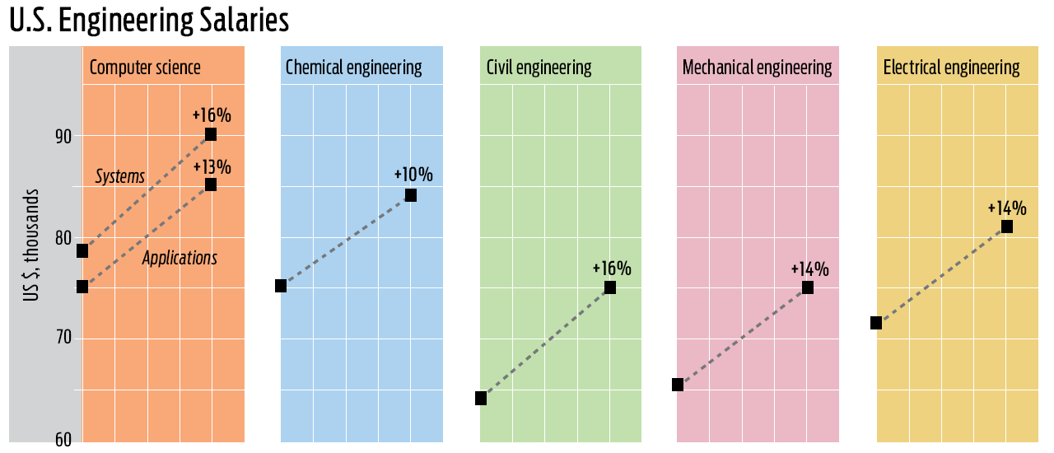
Why Study Software Construction?
1-<number>

Slide 17
What will you get out of COMP2710?
Analyze problems to determine system requirements
Develop object-oriented software designs that map to requirements identified in analysis
Develop software using sound programming principles
Grasp both C++ Syntax and Semantics
Have experience in developing non-trivial software applications
Understand concepts of data abstraction, efficiency, and memory management
Understand how to perform software testing.
1-<number>

Slide 18
Topic Coverage
Covers (These topics may change)
  Administrative Stuff (Lecture 1)
  C++ Intro: History, Basics, through Flow of Control (Lectures 1-2)
  Basic I/O and Expressions (Lecture 2)
  Basic Functions and Strings (Lecture 3)
  Structures & Classes: Basics, Constructors (Lecture 4)
  Software Process (Basics of Analysis, Design, and Testing) (Lecture 5-6)
  Function Overloading and Templates (Lecture 7)
  Arrays (Lecture 8)
  Midterm Exam
1-<number>

Slide 19
Topic Coverage (cont.)
  File IO (Lecture 9)
  Pointers & Dynamic Arrays (Lecture 10)
  Function Templates and Vectors (Lecture 11)
  Operator Overloading (Lecture 12)
  Inheritance and Polymorphism (Lectures 13-14)
  Linked Data Structures (Lecture 15)
  Additional Topics covered as they occur: Separate Compilation, Makefiles, Templates
  Final Exam will be Tuesday December 9, 2014 12:00-2:30pm
1-<number>

Slide 20
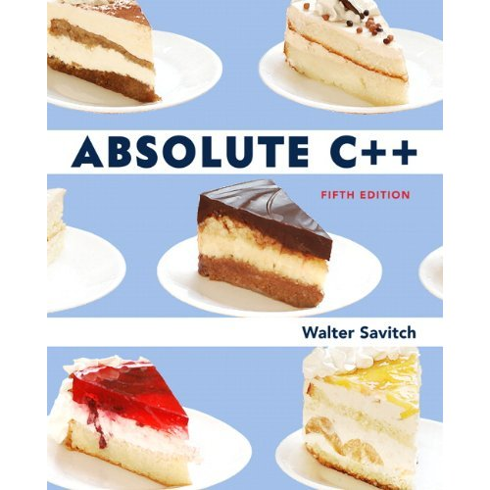
Am I going to read the book to you?
NO!
Book provides a framework and complete background, so lectures can be more interactive.
  You do the reading
  We’ll discuss it
Projects will go “beyond”
Textbook: Savitch, Walter. Absolute C++,
5th Edition. 2013 . Addison-Wesley.
1-<number>

Slide 21
Course Syllabus
Prerequisite: COMP 2210 Fundamentals of Computing.
3 homework assignments and 4 lab assignments.
  Late assignments will NOT be accepted without prior arrangement.
1 midterm exam and 1 final exam
Grading
  Class Participation
  Quizzes 10%
  Midterm 20%
  Final Exam 25%
  Homework Assignments 10%
  Lab Assignments 35%
1-<number>
Notes:
The syllabus is available on the course web site.
Read syllabus carefully after class
Prerequisite: Ask students’ background in assembly languages

Slide 22
Course Syllabus (cont.)
Scale
  A [90, 100], B [80,90), C [70,80), D [60,70), F [0,60)
  Note: In order to pass the class, you must receive at least 60% credit on the Individual Construction Projects and Homework, regardless of performance on exams.
Cheating
  All assignments have to be done individually.
  Students may discuss with their friends.
  Assignments submitted must be yours.
  Please do not attempt to recycle answers from the Internet (plagiarism).
1-<number>
Notes:
The syllabus is available on the course web site.
Read syllabus carefully after class
Prerequisite: Ask students’ background in assembly languages
Possible penalties: Zero on assignment (minimum), failure course, note on permanent record, suspension.

Slide 23
Office Hours
Dr. Lim’s Office hours: TR 3:00 pm – 4:00 pm
(or by appointment)
GTA: Steffi Mariya Gnanaprakasa P Arasu
Office: 2319 Shelby Center
Office Hours: MWF 11:00am – 12:00noon
(or by appointment)
Email: smg0033@tigermail.auburn.edu
1-<number>

Slide 24
For Next Time…
Read Chapter 1 – C++ Basics
1-<number>
Notes:
How hard to build
Importance of simplicity (wearing a seat belt); avoiding a personal disaster
Theory vs. practice

Slide 25

Questions
Please ask at any time!
1-<number>

Slide 26
C++ Basics 1: Introduction and Variables
These slides are adapted from notes by Dr. Walter Savitch (UCSD)

Slide 27
Introduction to C++
C++ Origins
  Low-level languages
    Machine, assembly
  High-level languages
    C, C++, ADA, COBOL, FORTRAN
  Object-Oriented-Programming in C++
Copyright © 2008 Pearson Addison-Wesley. All rights reserved.
1-<number>
1-<number>
Notes:
Please read Ch 1.1 on page 3
C is a subset of C++
The second most widely used language followed by C

Slide 28


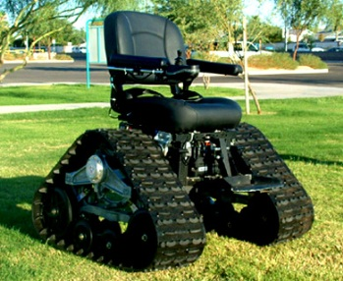
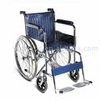
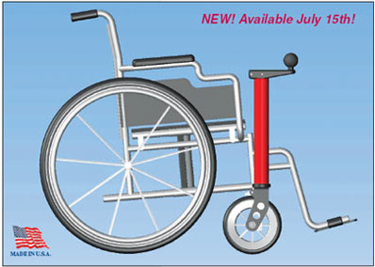
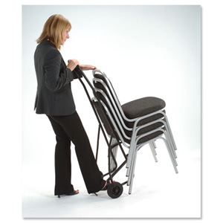
Characteristics of Object-Oriented Programming
Encapsulation
  Information hiding
  Combines both attributes (data) and functions
Inheritance
  Reusable code
Polymorphism
  A single name with multiple meanings
Example: Chair attributes (legs, back, …), actions: sit, push, move …
Example: “Move” a chair
1-<number>
1-<number>
Notes:
Please read Ch 1.1 on page 3
Example: Chair
Chair -> office chair
->

Slide 29
Some Similarities between
C++ and Java
Simple (primitive) types: int, double, char
Control Structures if-else, switch, while, for
Arithmetic expressions
Both have a string type: C++ string, Java String.
Arrays
Both have classes.
Both have a "main".
1-<number>

Slide 30
Some Differences between
C++ and Java
Java has automatic garbage collection. C++ does not.
C++ has operator overloading. Java does not.
C++ says "function". Java says "method".
1-<number>

Slide 31
More Differences
C++ classes can be avoided. Java classes cannot reasonably be avoided.
Variables get initialized in Java.
C++ has built in console I/O. Java has no standard console input (but does have standard console output.)
C++ and Java divide a program into pieces (for separate compilation) in different ways.
1-<number>

Slide 32
More Differences – Portability and Performance
C++ code is compiled. Java bye-code is interpreted via the Java Virtual Machine
C++ is NOT transferable between machines. Java is portable.
C++ code is faster than Java
1-<number>

Slide 33
Introduction to C++
C++ Terminology
  Programs and functions
  Basic Input/Output (I/O) with cin and cout
Copyright © 2008 Pearson Addison-Wesley. All rights reserved.
1-<number>
1-<number>
Notes:
Please read Ch 1.1 on page 4
Program is the main function

Slide 34
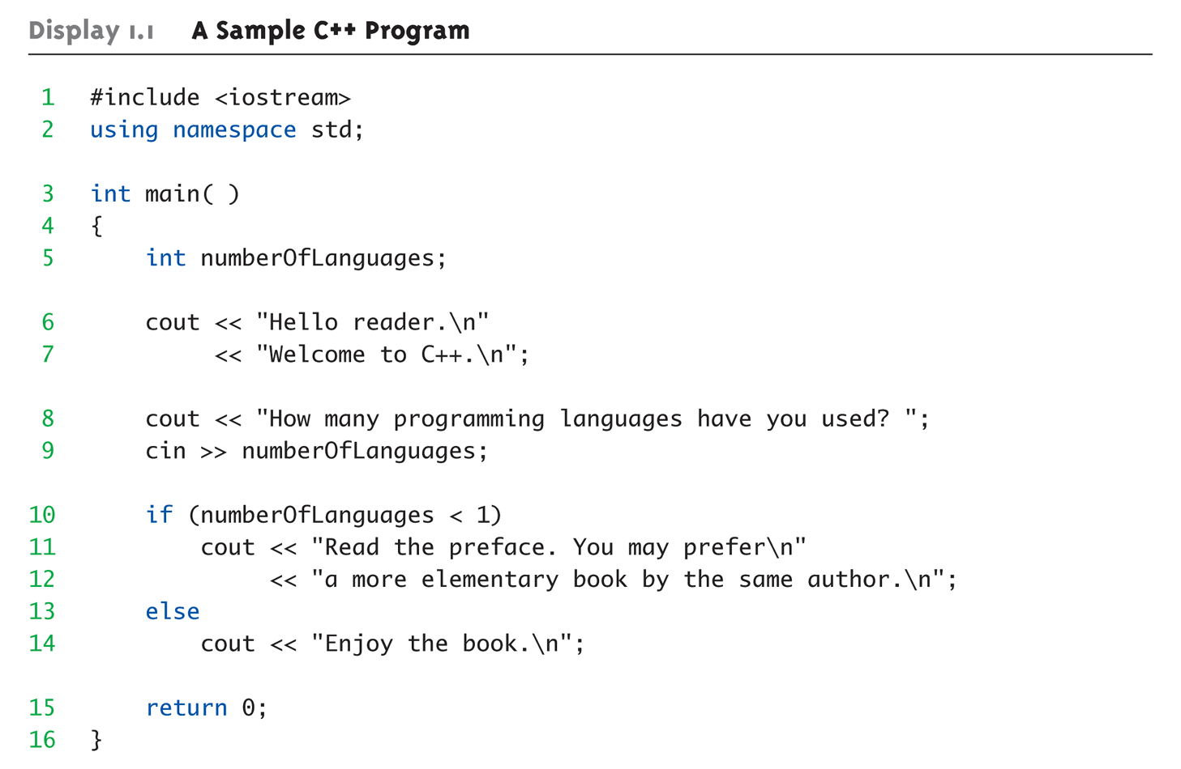
Display 1.1
A Sample C++ Program (1 of 2)
1-<number>
Notes:
main() may have parameters
return 0 -> int main()
cin is an object of class istream that represents the standard input stream. It corresponds to the cstdio stream stdin.
By default, most systems get their standard input from the keyboard, therefore cin is generally expected to get information from the user, although there are many cases where this can be redirected to some other source.
Because cin is an object of class istream, we can retrieve characters from cin either as formatted data using the extraction operator (>>) or as unformatted data using the read member function, among others (see istream).
cin is tied (see ios::tie) to the standard output stream cout, which means that cout's buffer is flushed (see ostream::flush) before each i/o operation performed on cin.
<< output operator or insertion operator

Slide 35
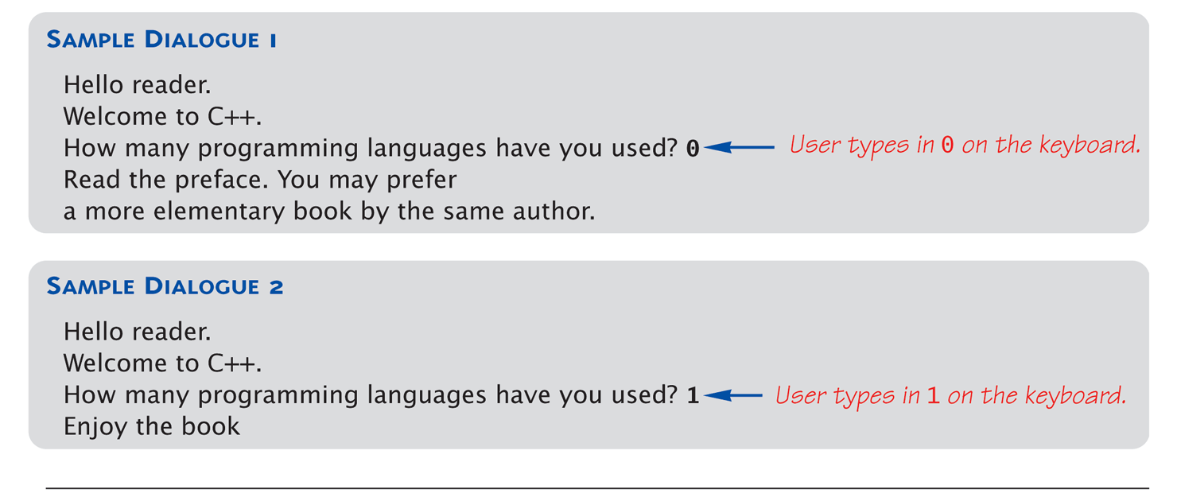
Display 1.1
A Sample C++ Program (2 of 2)
1-<number>

Slide 36
Lab Setup
Shelby 2119
Shelby 2122
SecureCRT: Linux terminal on your windows PC
  Remote Linux machines available are tux177 - tux192
  Physically in Davis 123
winSCP: Transfer files between your windows PC and a remote Linux server
Text Editor in Linux: Pico, vi, Emacs
Another option: Sun VirtualBox + Ubuntu (Linux)
1-<number>

Slide 37
SSH and SCP Access
SSH and SCP can be accessed off-campus
The campus has a license for SecureCRT for Windows 7/XP/Vista
SecureCRT and WinSCP are available for download from AUinstall (http://auinstall.auburn.edu).
1-<number>

Slide 38
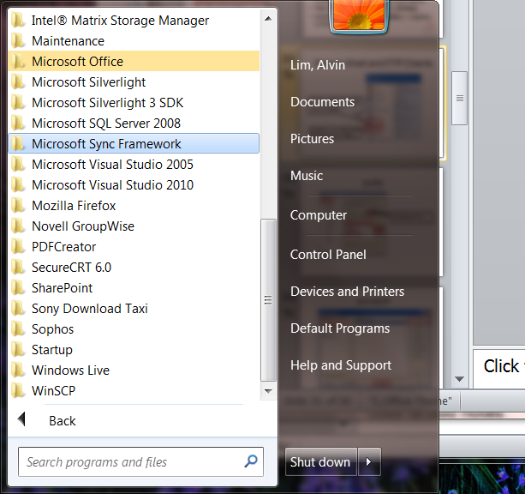
Secure Shell and FTP Clients
SecureCRT is a free implementation of Telnet and SSH for Win32 and Unix platforms
WinSCP is a very flexible SFTP and SCP client for Windows
1-<number>

Slide 39
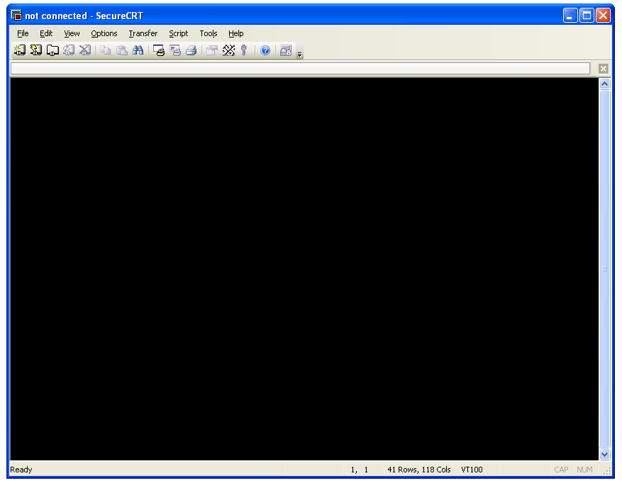
SecureCRT
Connect
1-<number>

Slide 40
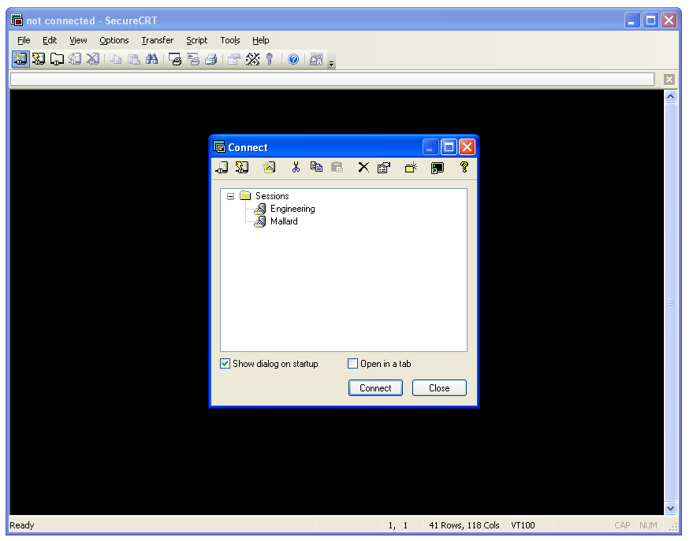
SecureCRT: New Session
Create a new session
1-<number>

Slide 41
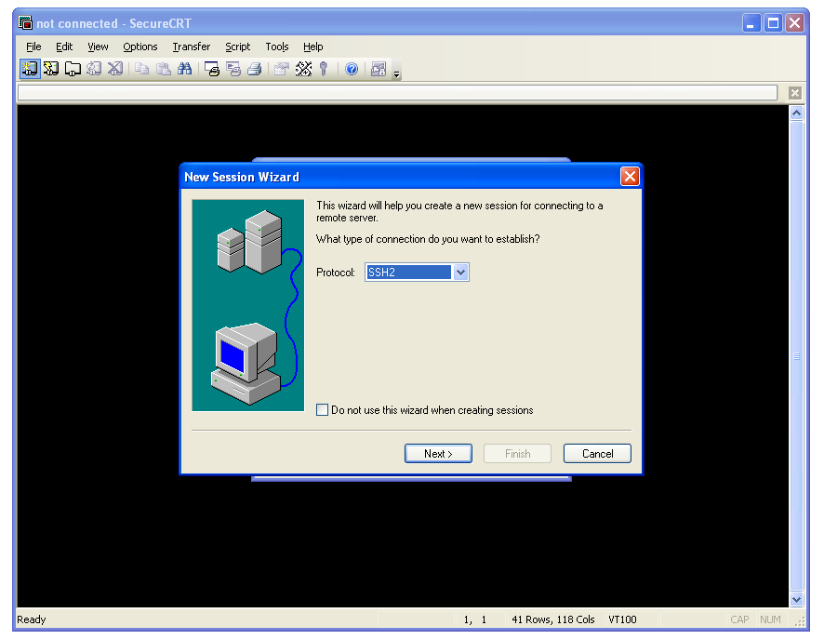
SecureCRT: New Session
1-<number>

Slide 42
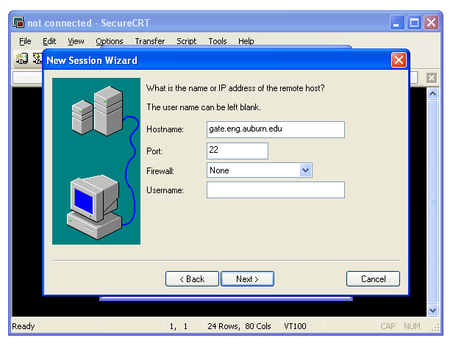
SecureCRT: New Session
1-<number>

Slide 43
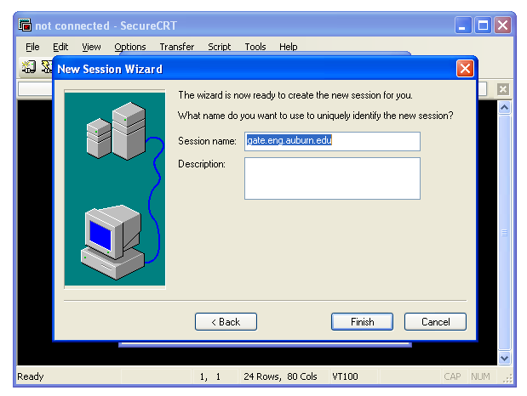
SecureCRT: New Session
1-<number>

Slide 44
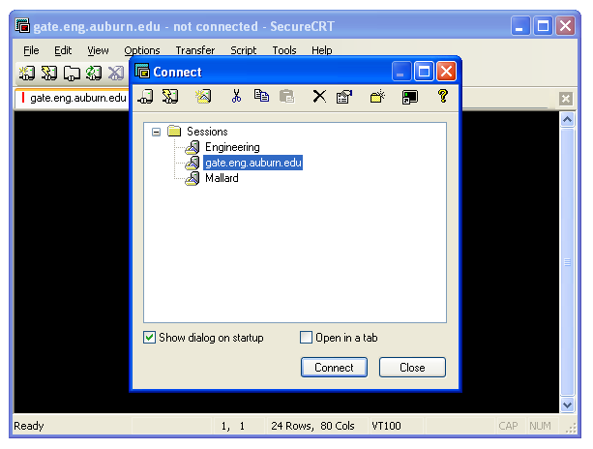
SecureCRT: Connect to a Saved Session
1-<number>

Slide 45
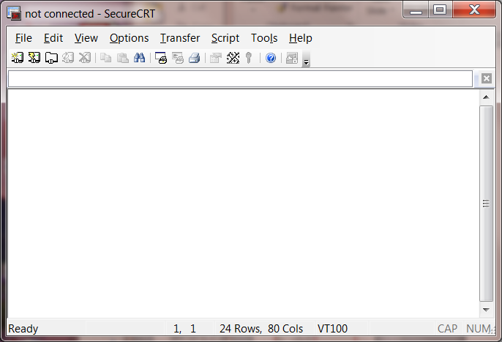
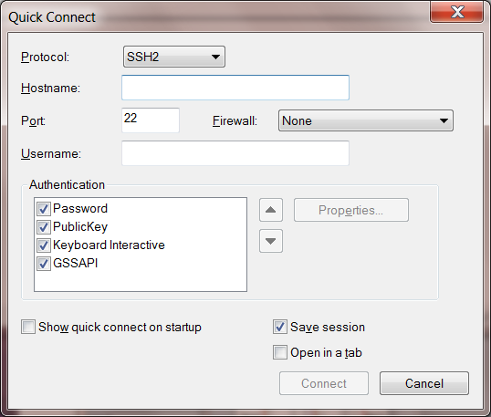
SecureCRT
Quick Connect
Make sure the protocol is SSH2
gate.eng.auburn.edu
Enter username
1-<number>
Notes:
Log into your H drive

Slide 46
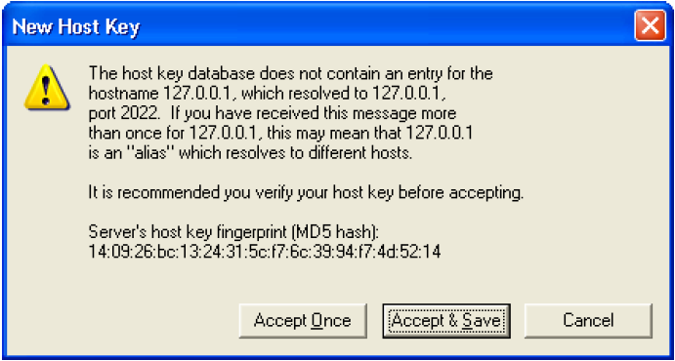
SecureCRT
1-<number>
Notes:
Log into your H drive

Slide 47
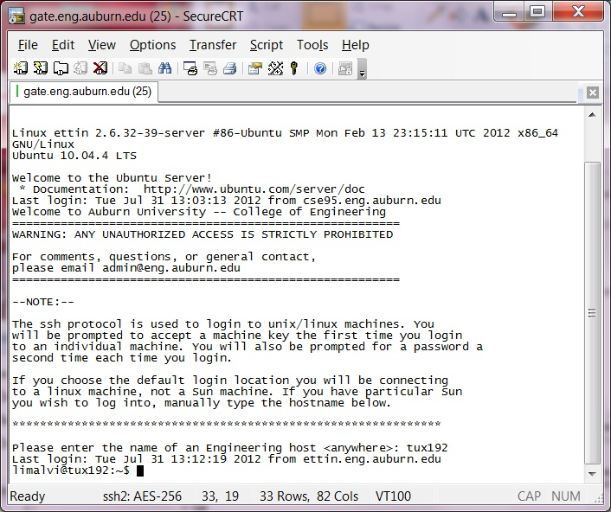
SecureCRT
Enter the tux computer name
1-<number>
Notes:
Log into your H drive

Slide 48
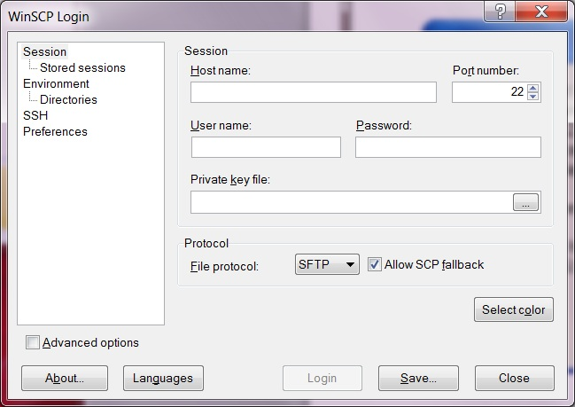
WinSCP
scp.eng.auburn.edu
Enter password
Enter username
1-<number>
Notes:
Log into your H drive

Slide 49
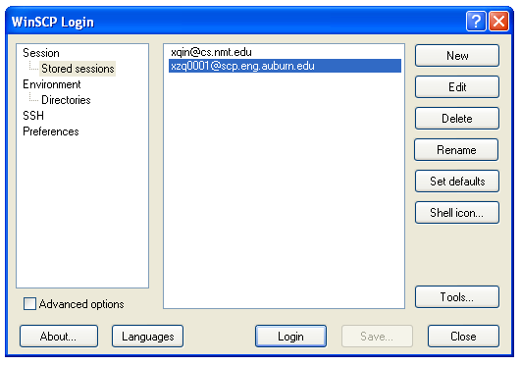
WinSCP
1-<number>

Slide 50
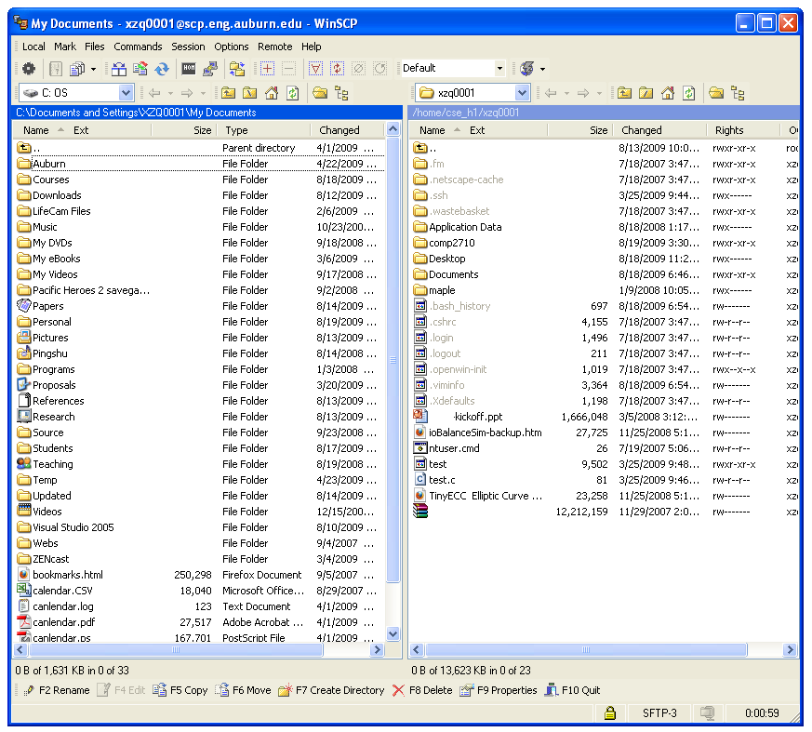
WinSCP (cont.)
Files at your Local PC
Files at the remote Linux server
1-<number>

Slide 51
FAQ: Mac Users
The SSH and SCP Client programs are different for the Mac.
SSH is included with MacOS.
There is a command-line SCP
You may download "Cyberduck" for SFTP transfers (server name - scp.eng.auburn.edu).
1-<number>

Slide 52
FAQ: Linux Users
Install two operating systems (i.e., Windows and Linux on your PC)
Virtual Machines. (e.g., VirtualBox; VMWare)
VirtualBox is running on Windows; Install Linux (e.g., Ubuntu in VirtualBox)
1-<number>

Slide 53
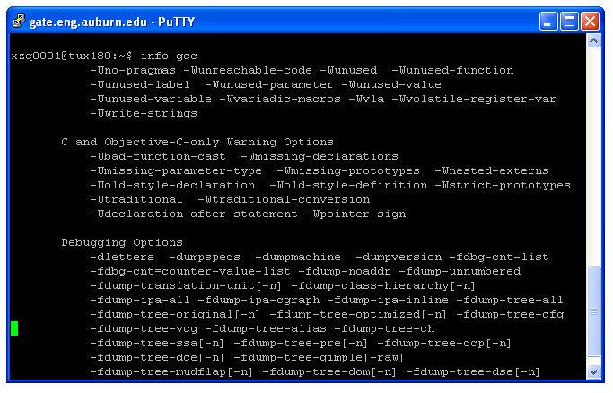
Learn More About g++: info gcc
1-<number>

Slide 54
Text Editors
Choose a text editor.
Some determining factors:
  What text editor is your professor using?
  Are you a computer science major or not?
  How much functionality do you want?
  After the initial learning curve, how fast do you want to be able to edit?
1-<number>

Slide 55
Pico
Pico is the easiest text editor to learn.
A non-graphical version of notepad.
The downside:
  Not every Unix/Linux machine has Pico installed.
  You can edit faster in other text editors after you’ve learned them well enough.
  Computer science majors who use Pico tend to be made fun of. (Just kidding)
1-<number>

Slide 56
Pico Basics
Open a file using “pico the_file”.
Move around just like you are in notepad.
Edit and delete using the normal keys.
Save using CTRL + O
Exit using CTRL + X
Go to a specific line number using CTRL + W, CTRL + T, and the number
1-<number>

Slide 57
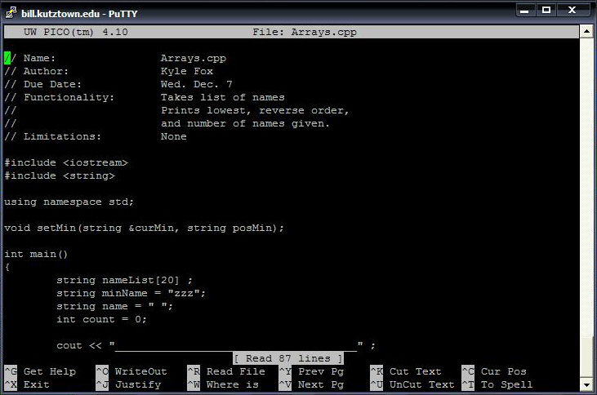
Pico Basic (cont.)
1-<number>

Slide 58
Vi
Vi is a feature rich editor located on almost all Unix/Linux machines around. Once learned, editing files is extremely fast.
The downside:
  It’s more complicated than Pico.
  It takes time to learn how to use vi.
  It’s easy to mess up your documents when you are first learning vi.
1-<number>

Slide 59
Vi Basics (1)
There are three modes to vi:
  Command mode (you start in this mode)
    It is used for entering commands
    The escape key always gets you back to command
  Insert/Append mode
    It is used for inserting or appending text
    From command mode, “a” will get you append mode, and “i” will get you insert mode.
  Line mode
    The “:” from command will get you to line mode.
    It is used for controls like saving and exiting.
1-<number>

Slide 60
Vi Basics (2)
Open a file using “vi the_file”.
Save using “w” (write) from line mode.
Quit using “q” (quit) from line mode.
Combine the two to save and quit “wq”.
Go to line using “#a_number” from line mode.
Delete a character using “x” from control mode.
Delete a line using “dd” from control mode.
1-<number>

Slide 61
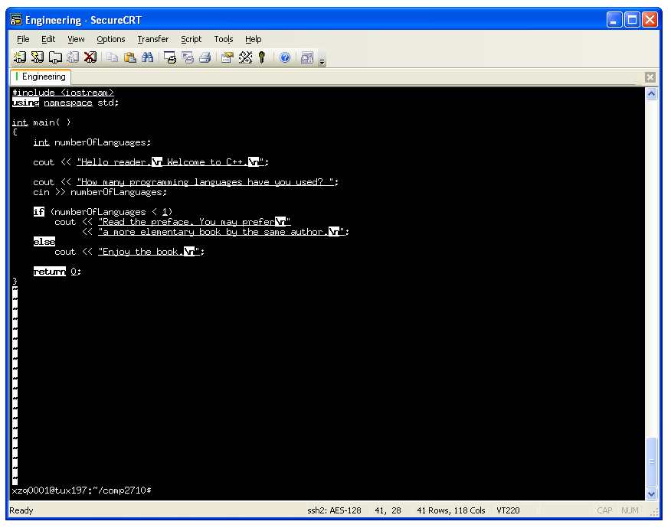
SecureCRT and the vi Editor
1-<number>

Slide 62
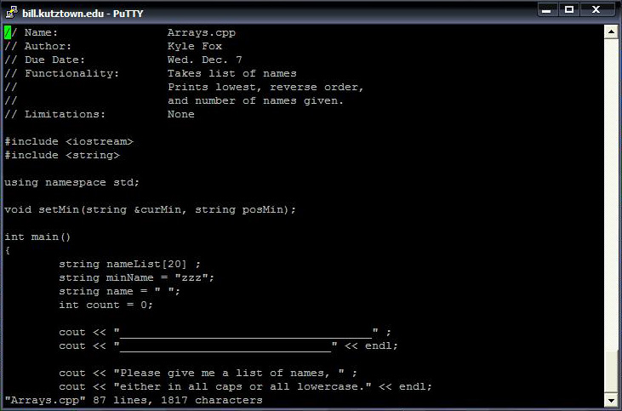
Vi Image
1-<number>

Slide 63
Emacs
Emacs is an extendable, customizable, versatile editor capable of doing much more than a regular editor.
It is able to be integrated with GDB, the debugger used for C++.
The downside:
  It is more complicated than Pico
  It’s going to take time to learn how to get around.
1-<number>

Slide 64
Emacs Basics(1)
Open a file using “emacs the_file”.
  Note: once emacs opens, you will need to use ctrl-l to move to the file you are editing.
Save a file using ctrl-x, ctrl-s
Exit using ctrl-x, ctrl-c
Go to line using alt+g, g
Stop emacs by using ctrl-g
1-<number>

Slide 65
Compiling a C++ Program
To compile a c++ program, use the g++ command. “g++ helloworld.cpp”
  Provided there are no errors, this will create an executable file called a.out.
  If you want to name your executable file, use the -o flag to specify a name.
  “g++ helloworld.cpp -o helloworld.out”
1-<number>

Slide 66
Running a C++ Program
Running a c++ program is easy, just type in the name of the executable file!
  “a.out”
There could be a minor issue however. If for some reason, that doesn’t work, try preceding the name with a ./
  “./a.out”
1-<number>

Slide 67
Break!
Let’s say you run your program, and realize it never stops! You are stuck in an infinite loop. You need a way to stop (or break) your program.
Use ctrl-c to stop a program running in an infinite loop
1-<number>

Slide 68
Core Files
If for some reason, you have a very bad error happen when you run your program, you may end up with a core dump.
What happens is that Unix saves all information about what happened to a file named “core”.
Make sure if this happens to you, that you remove the core file, because they are big, and can take up a lot of your space!
1-<number>

Slide 69
Wildcard
There exists a wildcard character. It is the asterix(*).
Wherever you put an asterix, Unix/Linux will try to put any character or word. So something like “*.cpp” will select every single .cpp file in your directory.
Careful! It can be handy, but dangerous! Using “rm *” would remove everything!
1-<number>

Slide 70
Summary
Characteristics of C++
C++ vs. Java
How to use SecureCRT and WinSCP?
How to use vi?
Compiling and running a C++ Program
1-<number>
1-<number>
Notes:
Give an example.

